Slide 1
RMPC data analysis pipeline
si13C, VCO2, VO2, RQ etc.
Time series data
CalR
Cage data:
not aligned time series data
App1:
Cage data alignment & summary
Mouse level
w/repeat measures
Metadata:
Start time
Mouse ID
Condition
Body mass
etc.
Mouse level
App2:
nmolar calculator
Fcirc/Vox
Statistical analyses
App3:
ANOVA / ANCOVA / GLM
Plasma data:
C13Labels
Mouse level or longitudinal
(w/repeat measures)
App4:
Linear Mixed-Effects Model

Slide 2
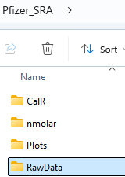
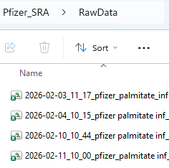
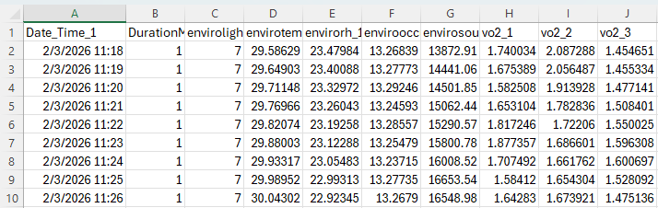
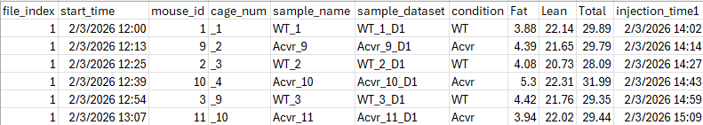
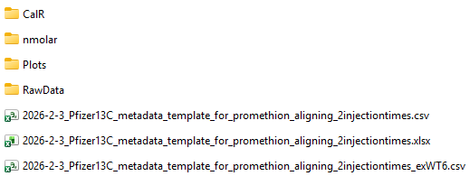
Cage data:
not aligned time series data
Metadata:
Start time
Mouse ID
Condition
Body mass
etc.
Mouse level

Slide 3
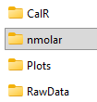
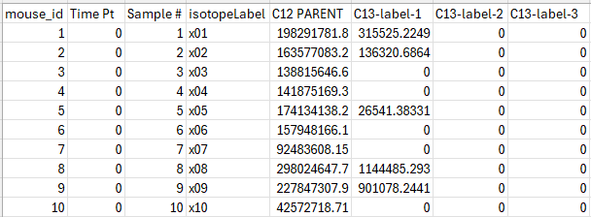
Plasma data:
C13Labels
Mouse level or longitudinal
(w/repeat measures)

Slide 4
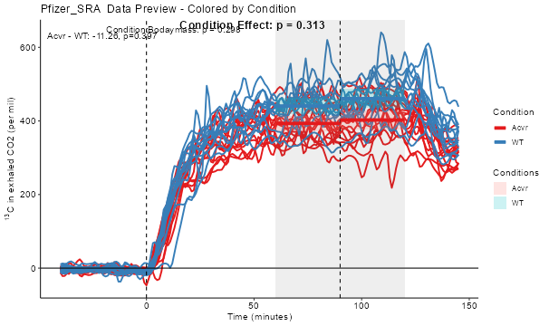
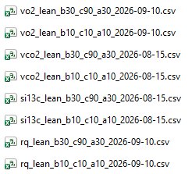

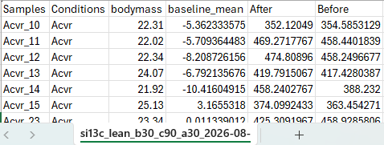
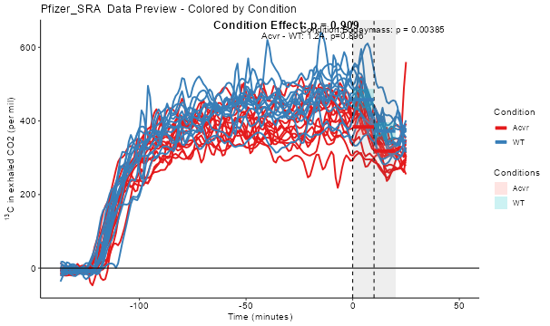
App1:
Cage data alignment & summary
Align w/start time
Get data at certain time points for each subject
- average over a period
Align w/injection time

Slide 5
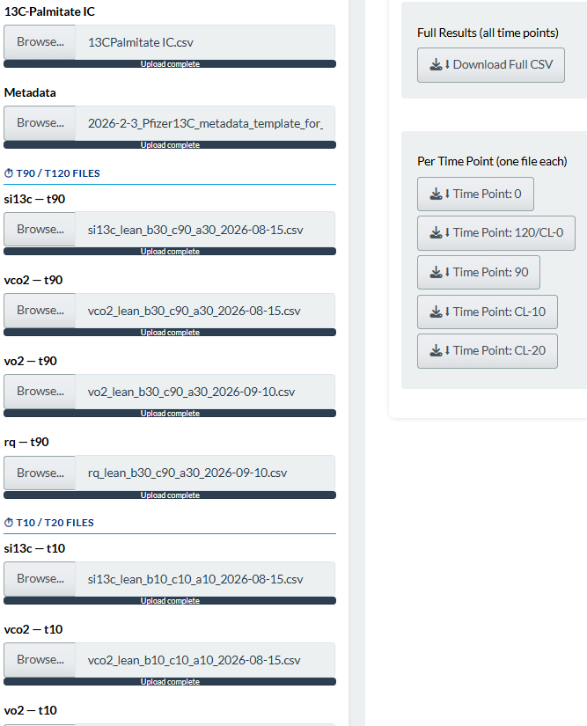

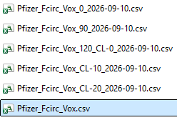
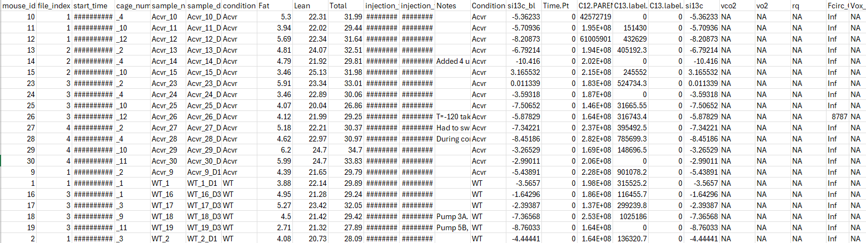
App2:
nmolar calculator

Slide 6
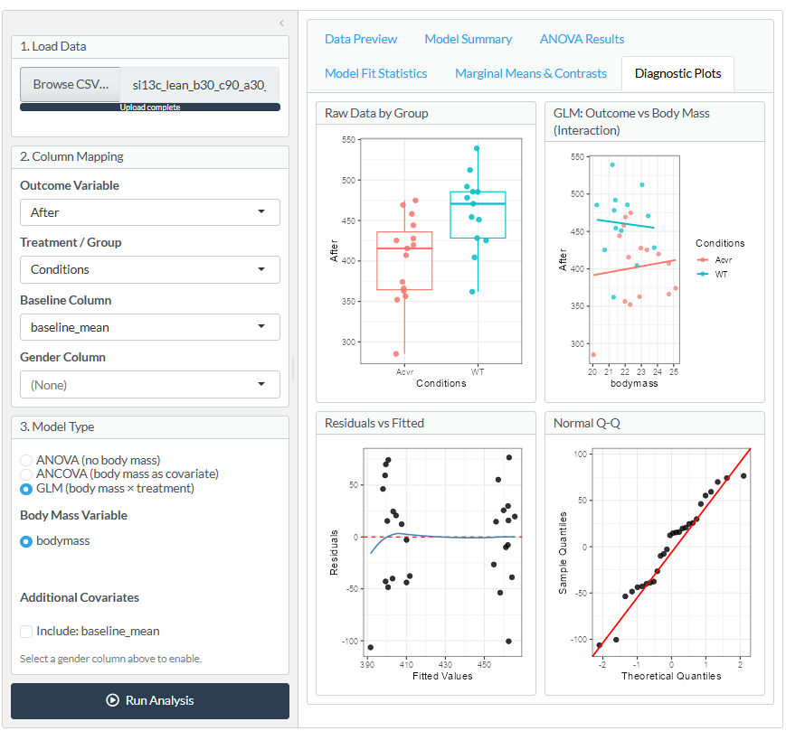
App3:
ANOVA / ANCOVA / GLM
One point estimate
w/BL adjustment option
Input data: App1 outputs

Slide 7
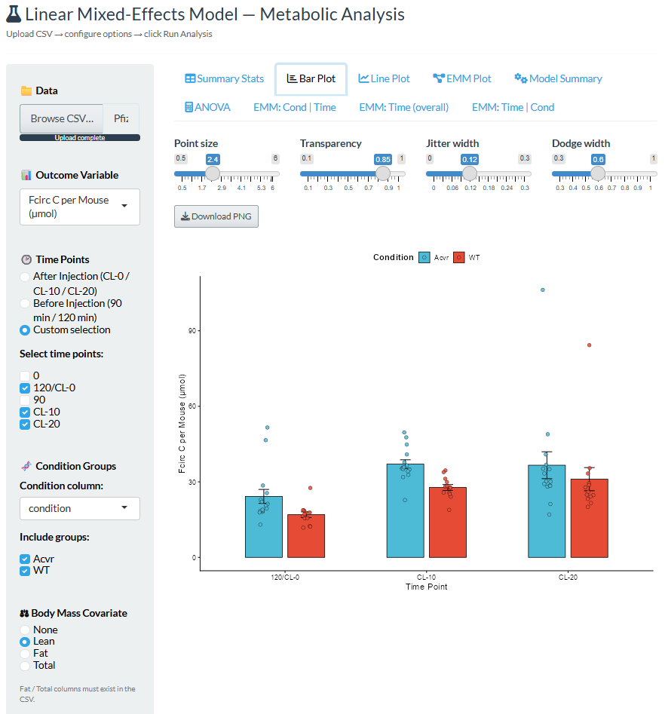
App4:
Linear Mixed-Effects Model
With repeated measures
More than two time points

